Slide 1



Foundation of Cloud IoT Edge ML
Dr. Rajiv Misra
Professor, Dept. of Computer Science & Engg. Indian Institute of Technology Patna rajivm@iitp.ac.in

Slide 2
On completion of this Lecture you will get to know about the following:
Understanding of today’s cloud scenario
Different objectives of cloud
Current limitations of traditional cloud
Why there is a need of Edge Computing?

Slide 3
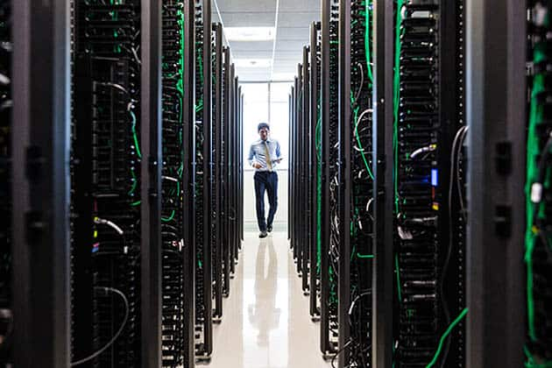
Current State of Today’s Cloud
Highly centralised set of resources
Compute is going beyond VMs
Storage is complemented by CDN
Network stack is programmable
The Web and Software-as-a-Service
Infrastructure-as-a-Service
High-Availability cloud

Slide 4
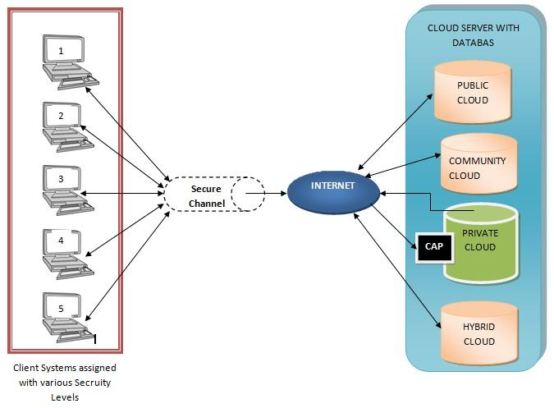
Current State of Today’s Cloud: Highly Centralized in Client-Server Architecture
Cloud computing started as all about virtual machines that were running in a remote data center (or storage).
Highly centralized architecture closely resembles 90s client-server computing.
For example cloud (the remote data center or the remote infrastructure) exposed by Amazon, Microsoft, Google, IBM and others is the server and the machine from which you are connecting to it and consuming the cloud resources is the client.

Slide 5
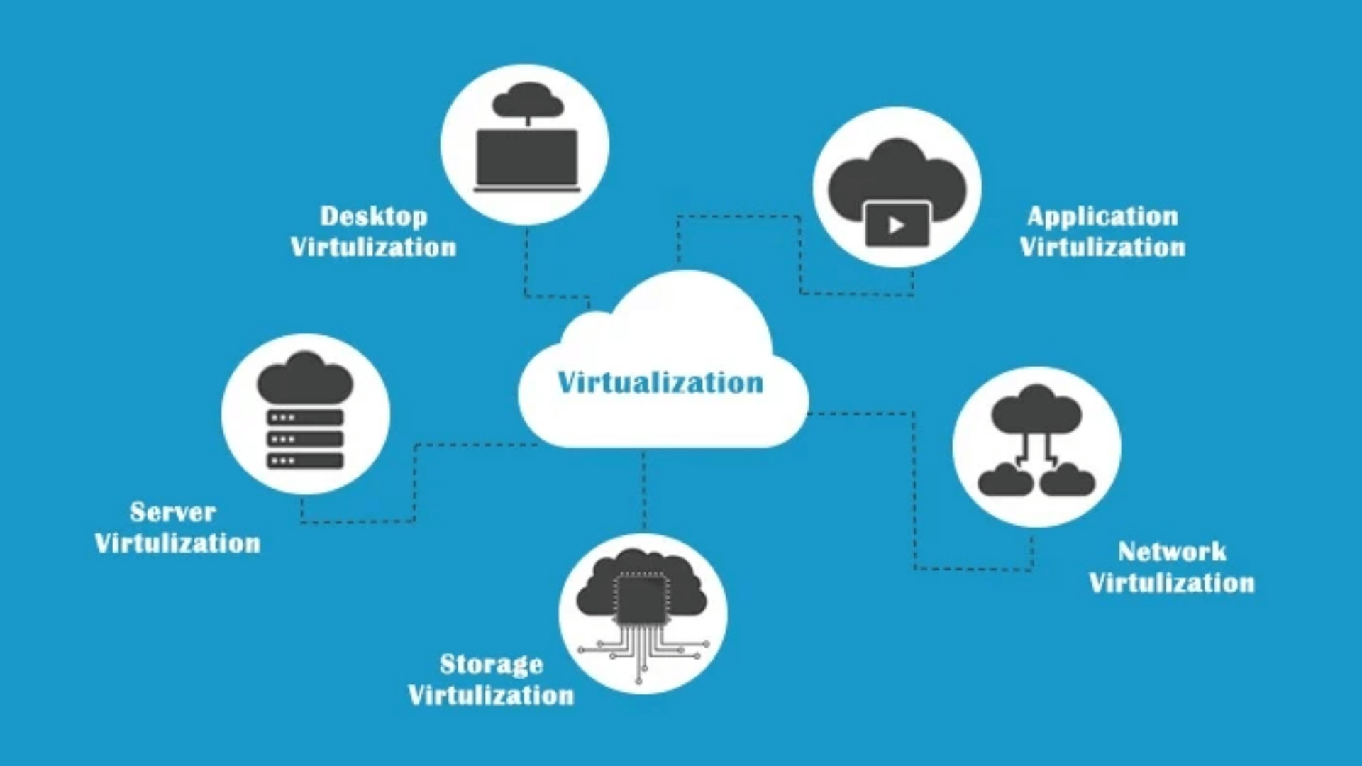
Current State of Today’s Cloud: Compute is going beyond VMs
Although cloud resembles the 90s client-server computing but at the same time compute has gone beyond VMs the first generation of cloud was all about VM virtual machines.
Where you could programmatically launch a VM and you could SSH into it and take control of the Virtual Machine and install the software.
But there is a dramatic shift in the compute where VMs are slowly getting replaced by containers.
More and more workloads are moving towards containers.

Slide 6
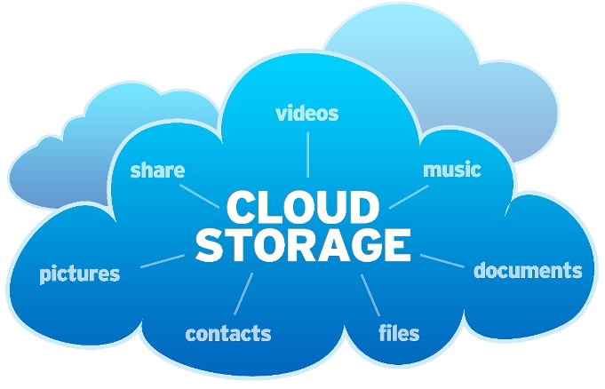
Current State of Today’s Cloud: Storage is complemented by CDN
Another important trend almost all the public cloud are in storage offerings.
Object storage is complemented by a content delivery network today.
Whenever you put an object in a bucket or a container of the public cloud storage you can click a check box to basically replicate and cache the data across multiple edge locations but this edge is not the edge that we are talking about this is the content delivery network where it caches the frequently accessed content in a set of pop or edge locations.

Slide 7
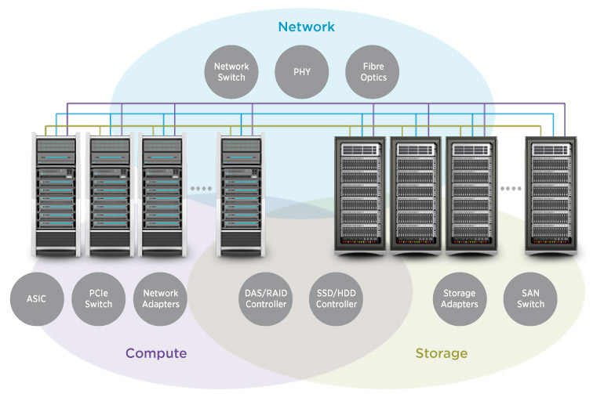
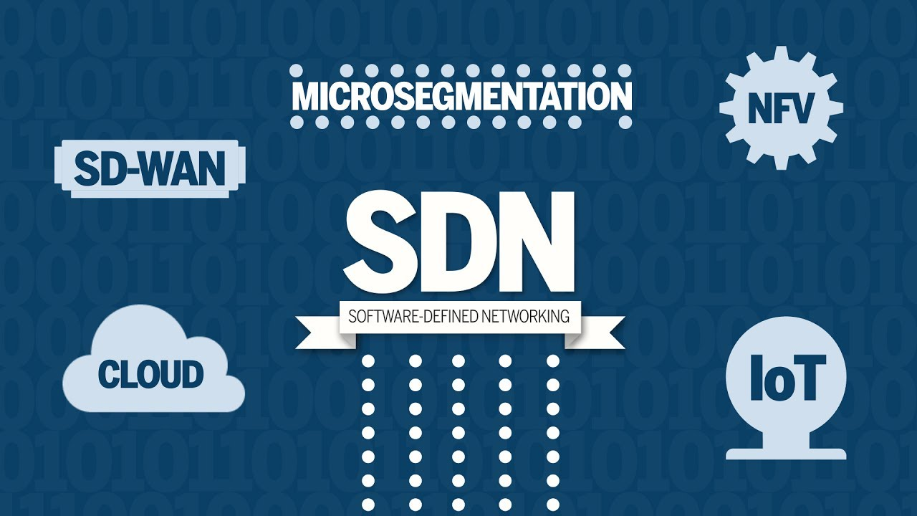
Current State of Today’s Cloud: Network stack is programmable
Finally network has become extremely programmable today.
If you look at the hybrid cloud, multi-cloud scenarios and how network traffic is getting routed and how load balancers firewalls and a variety of network components are configured it is through api's and programmability.
The same capability of SDN is enabling hybrid scenarios particularly when we look at the combination of software-defined network with some of the emerging networking technologies.
These mesh they are opening up additional avenues some of the very recent trends like Google’s Anthos, IBM cloud private and some of the other container based hybrid cloud platforms are heavily relying on the programmable Network stack and also a combination of SDN with service mesh.
This is the current state of the cloud and these trends represent how the cloud is currently being consumed or how it is delivered to customers but cloud is going through a huge transformation.

Slide 8
Multiple waves of innovation in Cloud: Pass to IOT
Initially cloud was all about compute storage and network resources globally available highly centralized set of resources because cloud made compute and storage extremely cheap and affordable lot of industrial customers and enterprises started connecting devices to the cloud.
The data that was not persisted or aggregated or acquired is now streamed to the cloud because it is extremely cheap to store data in the cloud.
So a lot of companies and lot of industrial environments started to take advantage of the cloud by streaming the data coming from a variety of sensors and devices.
Also use the cheaper compute power to process those data streams and make sense out of the raw data generated these sensors and devices and that was the next big shift in the cloud this was IOT pass.

Slide 9
Challenges for IOT-Pass
If you look at azure IOT, Google Cloud IOT, AWS IOT core all of them essentially give you a mechanism a platform to connect devices and store data and process it in the cloud but it was not sufficient or it was not enough to address a lot of scenarios while cloud enabled capabilities like Big Data and IOT.
Lot of customers were not ready to move the data to the cloud that is one challenge.
The second one is the round trip from the devices to the cloud and back to the devices was too long and it was increasing the latency in a lot of mission-critical industrial IOT scenarios.
Sending the data to the cloud and waiting for the cloud to process it and send the results back was just not feasible so there had to be a mechanism where data could be processed locally and compute comes much closer to the devices or the sources of data so that's how IOT led to edge computing and today almost every mainstream enterprise IOT platform has a complimentary edge offering and associated edge offering and more recently there has been a lot of focus on artificial intelligence.

Slide 10
Cloud for AI-ML
Today’s cloud has become the logical destination for training and running artificial intelligence and machine learning models.
Due to accelerators like GPUs GPUs FPGAs it has become extremely cheap and also powerful to train very complex very sophisticated ML models and AI models
But in most of the scenarios a model that is restrained in the cloud is going to be run in an offline environment.
For example, you might have trained an artificial intelligence model that can identify the make and model of a car and automatically charge the tall fee for that vehicle when it passes through the toll gate now since the toll gates are on highways and freeways with very little connectivity and almost with no network access you need to run this model in offline scenario.
So edge computing became the boundary for running these cloud trained AI models but running in an offline mode within the edge so that is how we are basically looking at the evolution of cloud and on the waves of innovation.
So cloud are distributed or rather decentralized platform for aggregating storing and processing data with high performance computing IOT brought in all the devices to the cloud with IOT data at edge made cloud decentralized by bringing compute closer to the data source and now it is AI that is actually driving the next wave where cloud is becoming the de facto platform for training the models and edge is becoming the de facto platform for running the models so one is called the training the other one is called inferencing.

Slide 11
Limitations of current cloud system
AI use cases need real-time responses from the devices they are monitoring.
Cloud-based inference cannot provide this real-time response due to inherent issues with latency.
If edge devices have connectivity issues or no internet connection it can not perform well.
Sufficient bandwidth required to transfer the relevant amount of data in a proper time frame can also be an issue.

Slide 12
Evolution of Cloud
Virtual machines running in a remote data center or storage that was offered in a remote data center
Data processed locally and compute comes much closer to the devices or the sources of data
Cloud
IoT
Edge
Edge ML
VMs getting replaced by containers and workloads are moving towards containers
Training the models on edge also called inferencing

Slide 13
Summary of this lecture
Today’s cloud is highly Centralized in Client-Server Architecture
Compute is going beyond VMs
Storage is complemented by CDN
Network stack is programmable
Multiple waves of innovation in Cloud
Challenges for IOT-Pass
Evolution of Cloud towards Edge Computing

Slide 14


